Slide 1




Meeting the Housing Needs of RI’s Older Adults
A presentation to the
Housing Affordability Commission and the
Long-Term Care Coordinating Council
Brenda Clement
Executive Director
April 25, 2024
HousingWorks RI at RWU

Slide 2



Grant-funded Research Project
Two-year research project for research & policy recommendations
Input from public, nonprofit, and private organizations
Qualitative and quantitative research
Notes:
Return to this slide to build out

Slide 3

RI Adult Population & Households, 18 & older
Of a total population of 1,091,949
48% are aged 50 and older
Of a total 426,769 households
58% have a head of household aged 50 and older
Source: HWRI Analysis of US Census, PUMS, 5YR Est., 2017-2021

Slide 4
Income Quintiles by Age Cohorts
Figures represent upper limit of each quintile, except for highest
$80,000 $52,838 $28,308
Median Household Incomes for each age group
Source: HWRI Analysis of US Census, PUMS, 5YR Est., 2017-2021
Notes:
2000 and 2019 5 year estimates

Slide 5
Cost Burdens by Tenure, Head of HH aged 50-64
Of 133,650 total households:
More than 50% own a home with a mortgage; 20% own without a mortgage.
29% are renter households (38,388).
Of households reporting cost burdens:
Nearly 23,000 homeowners are cost-burdened (more than 9,000 severely).
Nearly 50% of these renter households are cost-burdened; more than 8,200 severely.
Source: HWRI Analysis of US Census, PUMS, 5YR Est., 2017-2021
5
Notes:
2000 and 2019 5 year estimates

Slide 6
Cost Burdens by Tenure, Head of HH aged 65-79
Of 87,138 total households:
35% own a home with a mortgage; 39% own without a mortgage.
26% are renter households (22,588).
Of households reporting cost burdens:
More than 19,000 homeowners are cost-burdened (nearly 8,500 severely).
52% of these renter households are cost-burdened; more than 4,500 severely.
Source: HWRI Analysis of US Census, PUMS, 5YR Est., 2017-2021
6
Notes:
2000 and 2019 5 year estimates

Slide 7
Cost Burdens by Tenure, Head of HH aged 80+
Of 28,630 total households:
15% own a home with a mortgage; 48% own without a mortgage.
38% are renter households (10,762).
Of households reporting cost burdens:
More than 7,000 homeowners are cost-burdened (nearly 3,200 severely).
65% of these renter households are cost-burdened; more than 3,500 severely.
Source: HWRI Analysis of US Census, PUMS, 5YR Est., 2017-2021
7
Notes:
2000 and 2019 5 year estimates

Slide 8
Across all age cohorts:
Nearly 100,000 households fall into the two lowest income quintiles
More than 84,000 households are cost burdened; of which more than 37,000 (44%) are “severely” cost burdened
Numbers of Greatest Need

Slide 9
Older Adults Experiencing Homelessness
749
Adults aged 55 and older average about 14% of RI’s overall population experiencing homelessness.
From 2010 to 2019, this population grew nearly 187%, compared to the overall growth of 82% among all experiencing homelessness.
Since COVID-19 and the institution of the call center, methodologies are being addressed to determine who is experiencing homelessness.
261
Source: RI Homeless Management Information System (HMIS), 2010-2019
9

Slide 10
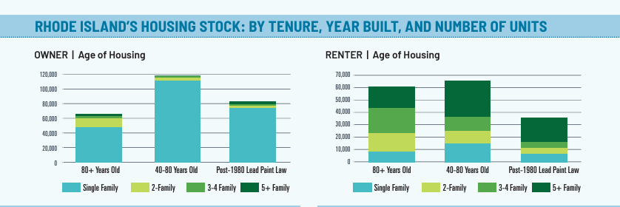
Prevalence of Older Housing

Slide 11
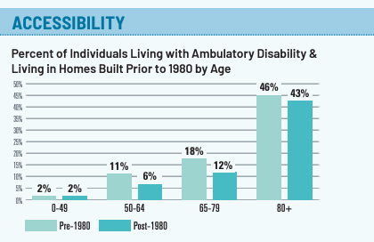
Disabilities & Older Housing
41,150
36,957
26,303
More than 100,000 adults aged 50 and older live with a disability; the majority live in homes built prior to 1980.

Slide 12
RI’s Rental Housing for Low-Income Older Adults
Less than 19,000 rental apartments subsidized by a mix of sources: Public Housing; Project-Based Section 8; LIHTC (new)
Some of these apartments are also allowed to be occupied by younger residents with disabilities
Income-eligible residents pay 30% of their monthly income toward rent: average approx. $400
Typically single-person household at Extremely Low or Very Low Income: $23,600 to $39,350
Occupancy currently stands at about 97%
Significant waiting lists across all developments and within housing authorities
Source: US HUD PD&R, Assisted Housing Dataset
(thank you to Peter Asen)

Slide 13
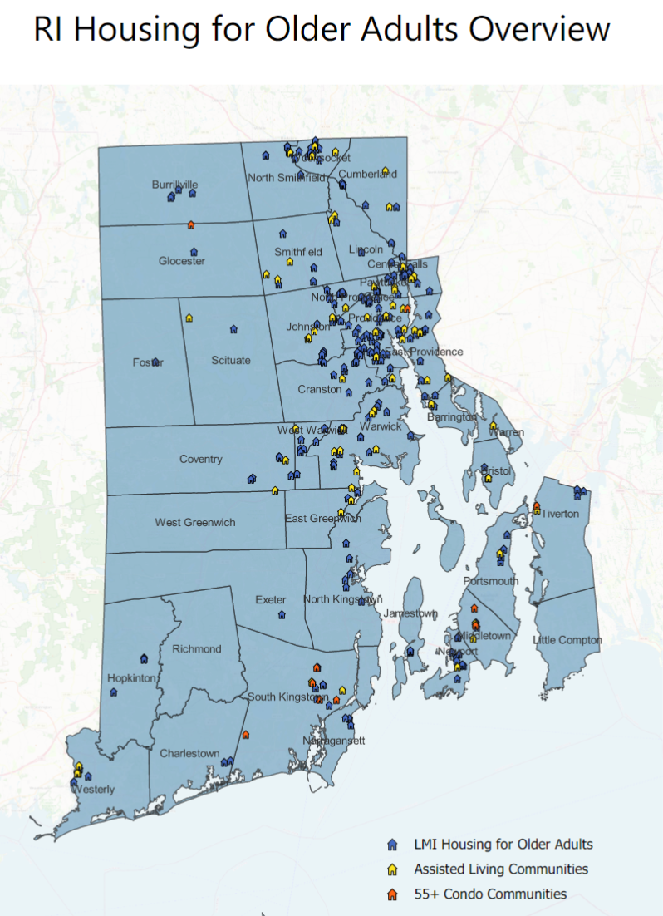
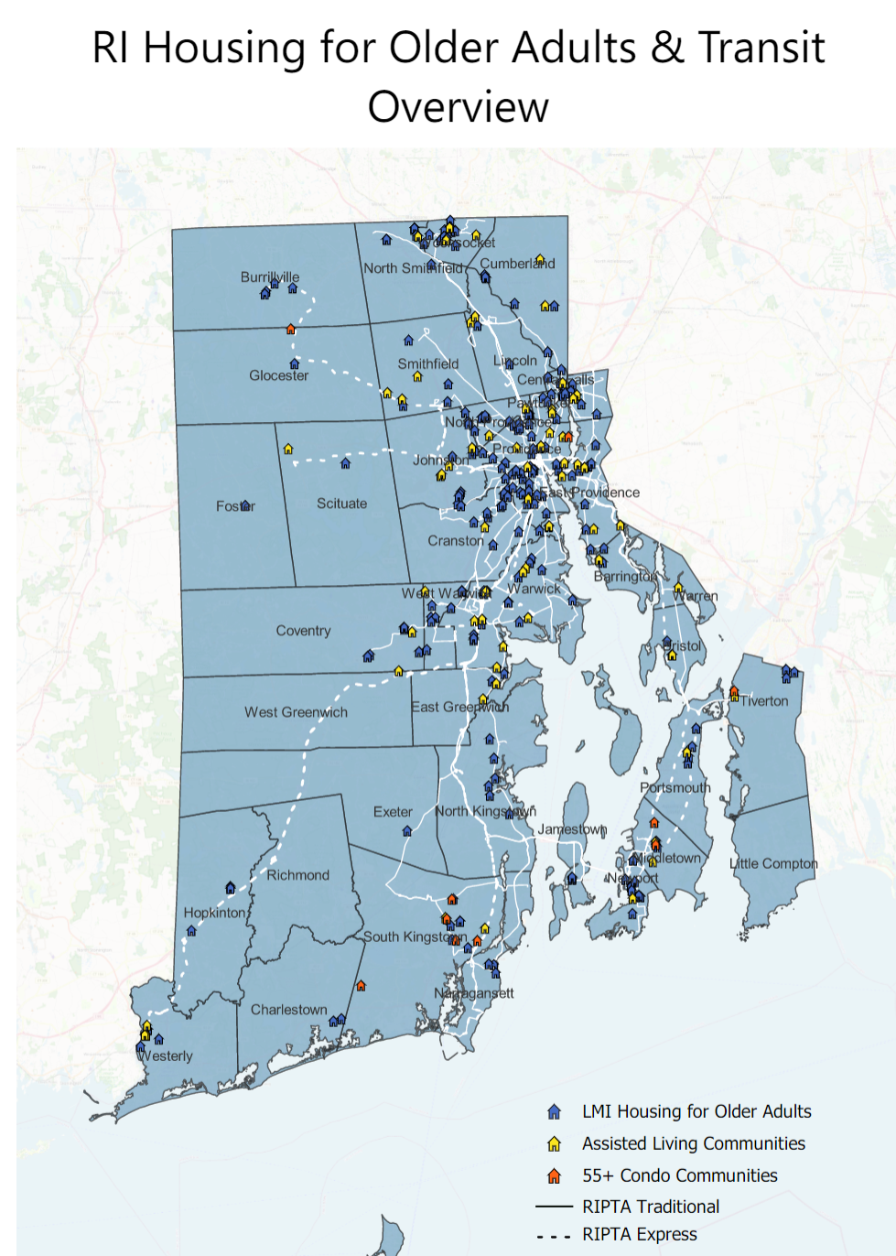
Notes:
Return to this slide to build out

Slide 14
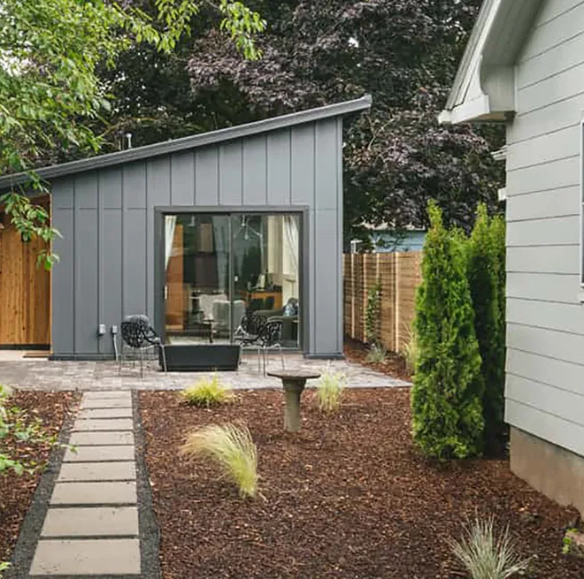
Housing Options for Older Adult Homeowners
Accessory Dwelling Units
  Cost on average $150-$300 per square foot ($120K-$360K)
Reverse Mortgages
Co-housing ranges, same as median home, plus association costs

Slide 15
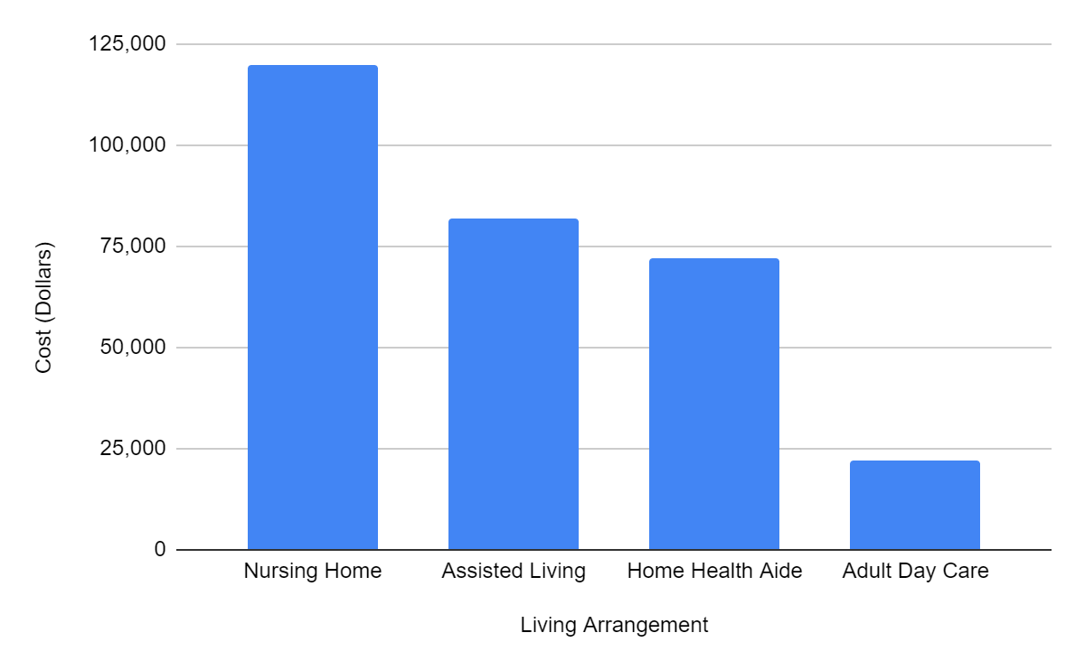
Housing with Healthcare Options for Older Adults
Assisted Living:
  $82K/year
Private Room in Nursing Home:
  Private Room, $120K/year
Home Health Aide at 44 hours/week:
  $72K/year
Adult Day Care at 5 days/week:
  $22K/year
Ages 50-64:
Median Income: $80,000
Ages 65-80
Median Income: $52,838
Ages 80+
Median Income $28,208
Comparing how much assisted living costs by state - Washington Post, December 5, 2023

Slide 16
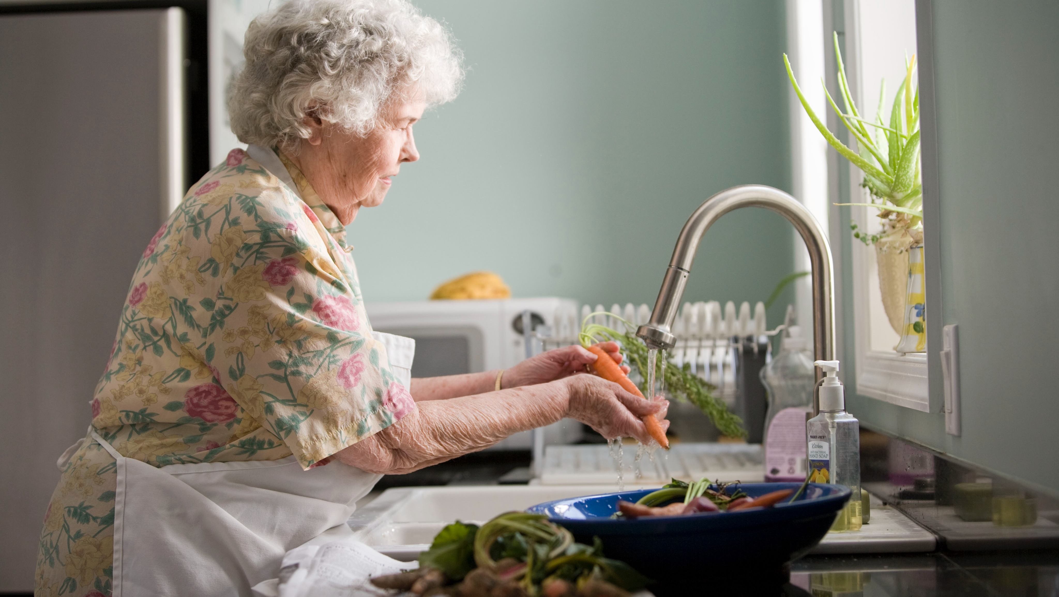



Thank You!
CONNECT WITH US!
HousingWorks RI
@hwri
www.HousingWorksRI.org
Notes:
Hyperlink or non-hyperlink on these?

